Slide 1
Linear Regression
Grace J. Hwang
Readings: Chapter 3, Abu-Mostafa, Magdon-Ismail, and Lin
Chapter 4, Mitchell

Slide 2
Outline
Introduction
Linear Classification
Linear Regression

Slide 3
Introduction (1/2)
Supervised learning is the most popular paradigm for machine learning.
In supervised learning, we are given a data set and already know what our correct output should look like, having the idea that there is a relationship between the input and the output.
Supervised learning problems can be further grouped into regression and classification problems.

Slide 4
Introduction (2/2)
Regression:
A regression problem is when the output variable is a real value, such as “dollars” or “height”.
Classification:
A classification problem is when the output variable is a category, such as “disease” and “no disease”.

Slide 5
Outline
Introduction
Linear Classification
Linear Regression

Slide 6
Linear Classification (1/4)
Example:
Students take a class on a Pass/Fail basis
Algorithm: Perceptron Training Rule (PTL)
Students | x₁ (Midterm) | x₂ (Final) | y (Pass/Fail)
A | 80 | 60 | +1 (Pass)
B | 50 | 50 | -1 (Fail)
C | 90 | 80 | +1 (Pass)
D | 30 | 60 | -1 (Fail)
E | 40 | 90 | +1 (Pass)
F | 90 | 50 | +1 (Pass)

Slide 7
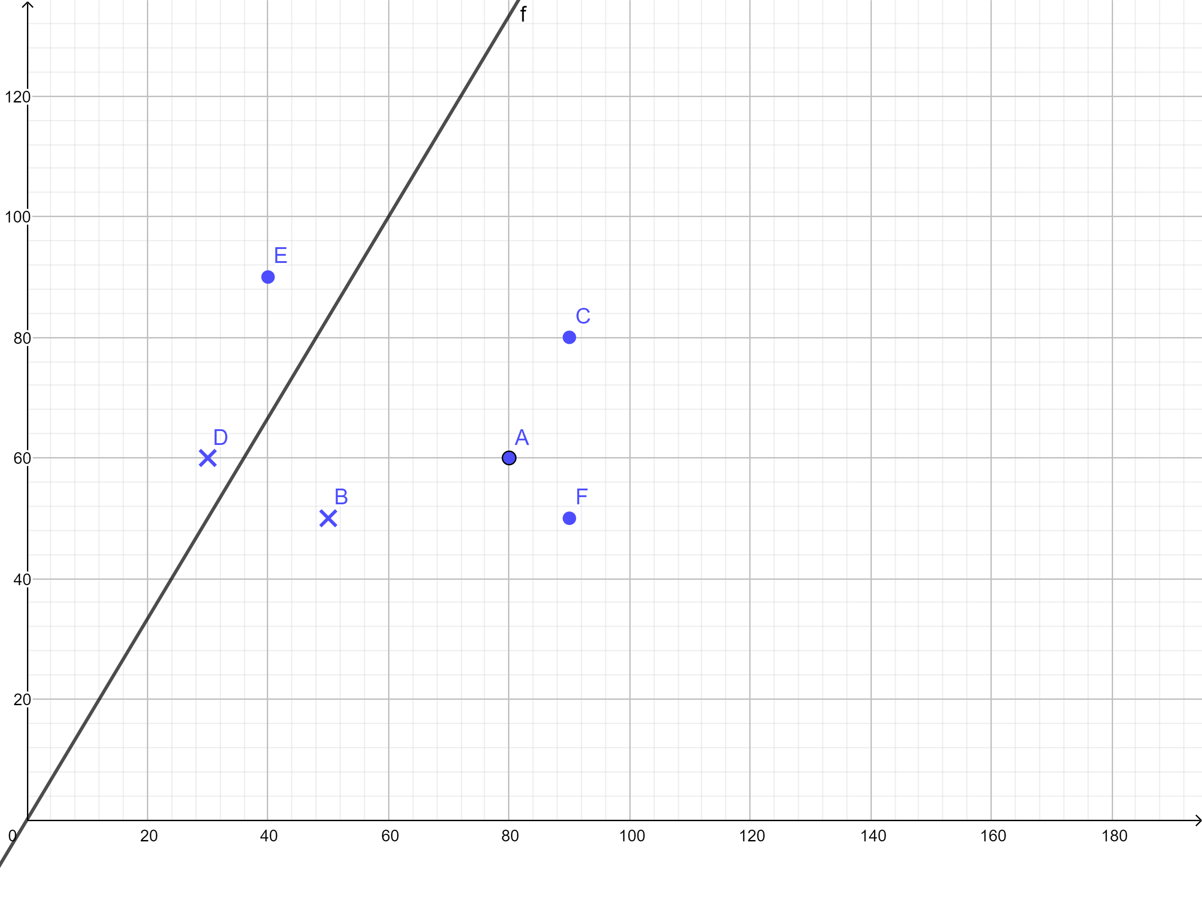
Linear Classification (2/4)
− Initial h
− Final h
− Another final h

Slide 8
Linear Classification (3/4)
For input x = (x₁, x₂) //grades of a students
Pass if w₁ x₁ + w₂ x₂ > threshold
((w₁ x₁ + w₂ x₂)− threshold) > 0
Fail if w₁ x₁ + w₂ x₂ < threshold
((w₁ x₁ + w₂ x₂)− threshold) < 0
This linear formula h ∈ H can be written as
h (x) = sign ((w₁ x₁ + w₂ x₂) − threshold)

Slide 9
Linear Classification (4/4)
h (x) = sign ((w₁ x₁ + w₂ x₂) − threshold)
Let w₀ = − threshold
⇒ h (x) = sign ((w₁ x₁ + w₂ x₂) + w₀ )
Introduce an artificial coordinate x₀ = 1:
⇒ h (x) = sign (w₀ x₀ + w₁ x₁ + w₂ x₂)
We can write h (x) in vector form:
h (x) = sign (w•x) // • inner product
where w = (w0, w1, w2) and
x = (x0, x1, x2) // x₀ = 1

Slide 10
What PTL does (1/2)
Given the training set: (x_{A}, y_{A}), (x_{B}, y_{B}), …, (x_{F}, y_{F}),
if a point, xn, is misclassified
(i.e., sign (w• xn) ≠ yn , n ∈ {A, B, …, F})
then update the weight vector w
w ← w + yn xn

Slide 11
What PTL does (2/2)
Consider a single example (x, y), there are two misclassified types.
Type 1:
y = 1 but h (x) = sign (w₀ x₀ + w₁ x₁ + w₂ x₂) = −1
⇒ PTL: w ← w + y x
⇒ PTL: w ← w + x // make w close to x
Type 2:
y = − 1 but h (x) = sign (w₀ x₀ + w₁ x₁ + w₂ x₂) = 1
⇒ PTL: w ← w + y x
⇒ PTL: w ← w − x // move w away from x

Slide 12
The PTL Algorithm
Given training data set:
D = {(x₁, y₁), …, (x_{N}, y_{N})} // N training examples
Initialize all weights w_{i} to random values
// w = (w₀, w₁, …, w_{M}); M+1 attributes
WHILE not all examples correctly predicted DO
FOR each training example xn ∈ D
If sign (w• xn) ≠ yn then w ← w + yn xn
Note: The PTL is guaranteed to converge if the training set is linearly separable.

Slide 13
Outline
Introduction
Linear Classification
Linear Regression (regression ≡ real-valued output)

Slide 14
Example
Data points of Price (= y) versus House size (= x) for sale in Berkeley, CA, in July 2009, along with the linear regression that minimizes squared error: ŷ = 0.232x + 246.

Slide 15
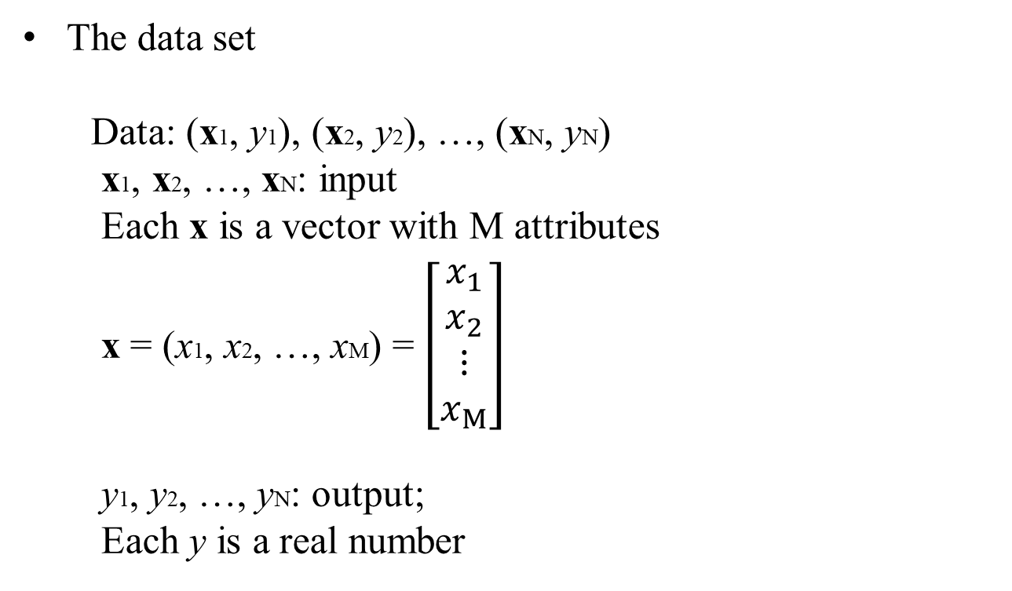
Data Representation
The data set
Data: (x1, y1), (x2, y2), …, (xN, yN)
x1, x2, …, xN: input
Each x is a vector with M attributes
x = (x1, x2, …, xM) = $\left[\begin{matrix}x_{1} \\ x_{2} \\ ⋮ \\ x_{M}\end{matrix}\right]$
y1, y2, …, yN: output;
Each y is a real number

Slide 16
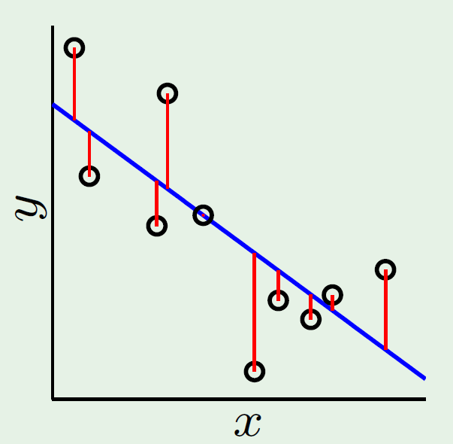
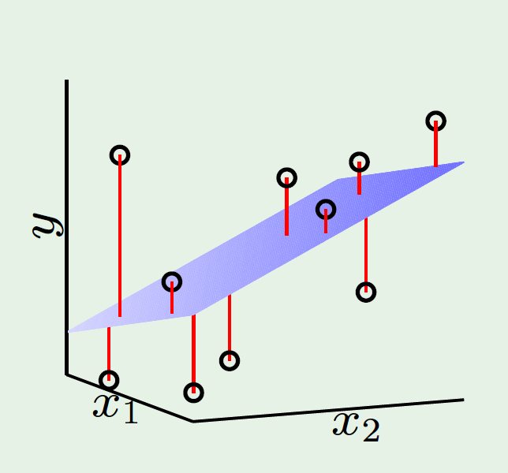
Illustration of Linear Regression
10 (= N) training examples
1 (= M) attribute; x
10 (= N) training examples
2 (= M) attributes; x1, x2

Slide 17
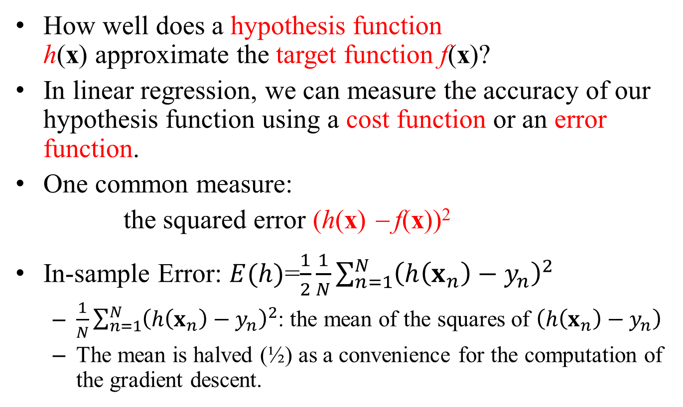
How to Measure the Error
How well does a hypothesis function h(x) approximate the target function f(x)?
In linear regression, we can measure the accuracy of our hypothesis function using a cost function or an error function.
One common measure:
the squared error (h(x) − f(x))²
In-sample Error: $E(h)$=$\frac{1}{2}\frac{1}{N}\sum_{n=1}^{N}{{\left(h\left(x_{n}\right)−y_{n}\right)}^{2}}$
$\frac{1}{N}\sum_{n=1}^{N}{{\left(h\left(x_{n}\right)−y_{n}\right)}^{2}}$: the mean of the squares of $\left(h\left(x_{n}\right)−y_{n}\right)$
The mean is halved (½) as a convenience for the computation of the gradient descent.

Slide 18
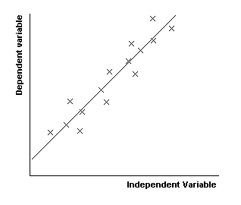
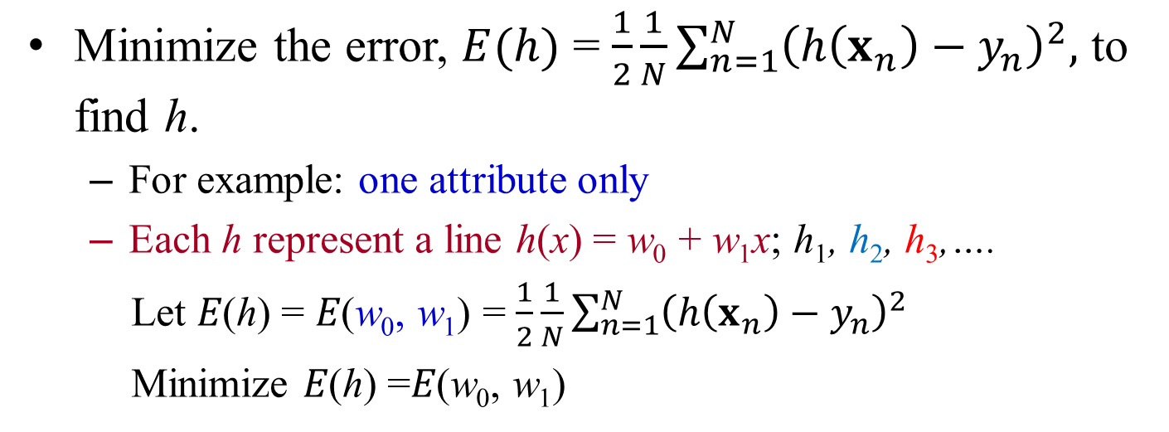
Minimizing Error Function
Minimize the error, $E(h)$ = $\frac{1}{2}\frac{1}{N}\sum_{n=1}^{N}{{\left(h\left(x_{n}\right)−y_{n}\right)}^{2},}$ to find h.
For example: one attribute only
Each h represent a line h(x) = w₀ + w₁x; h₁, h₂, h₃,….
Let 𝐸(ℎ) = 𝐸(w₀, w₁) = $\frac{1}{2}\frac{1}{N}\sum_{n=1}^{N}{{\left(h\left(x_{n}\right)−y_{n}\right)}^{2}}$
Minimize 𝐸(ℎ) =𝐸(w₀, w₁)
h₁ h₂ h₃
Note: w₀: y-intercept
w₁: the slope of line

Slide 19
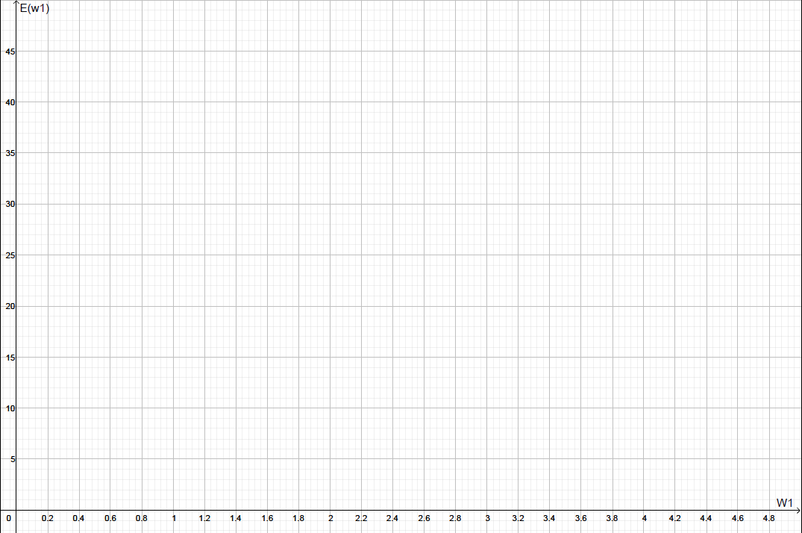
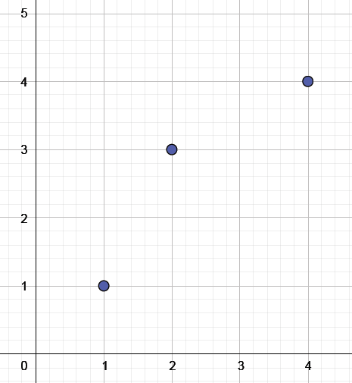
Error Function – one weight (1/2)
For the sake of simplicity, assume that w₀ = 0
// a line pass through the origin
Data:
(1, 1), (2, 3), (4, 4)

Slide 20
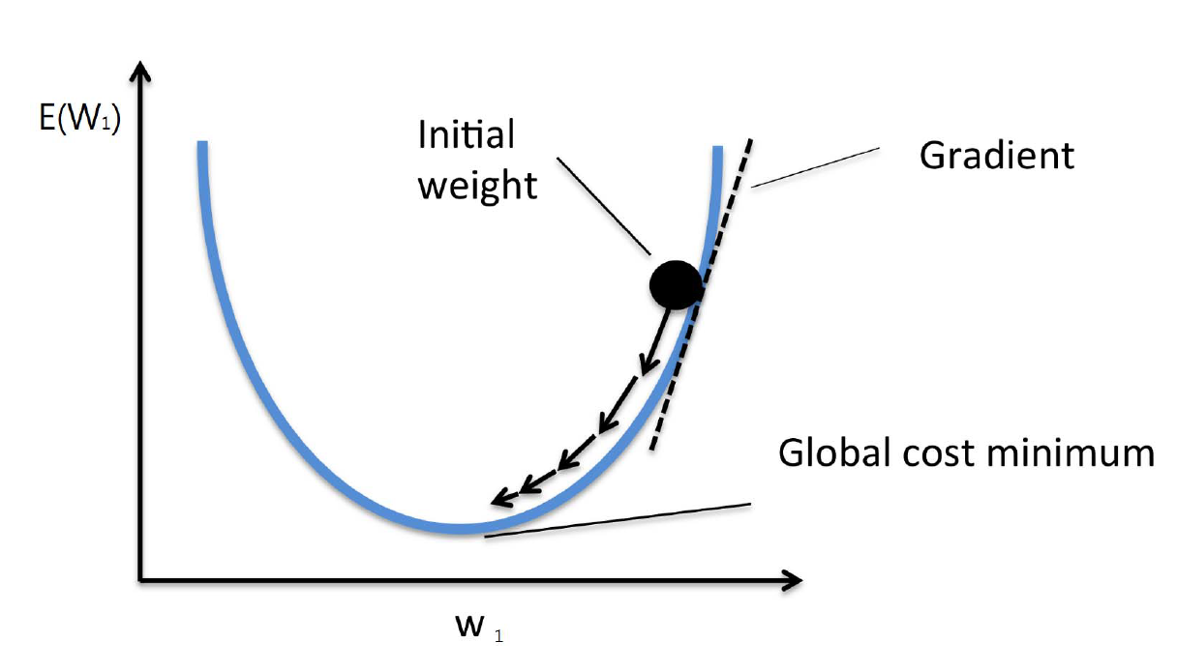

Error Function – one weight (2/2)
Example: one weight w₁
$$=\frac{d{E(w}_{1})}{dw_{1}}$$
Note: When w is a scalar, gradient is the tangent line.

Slide 21
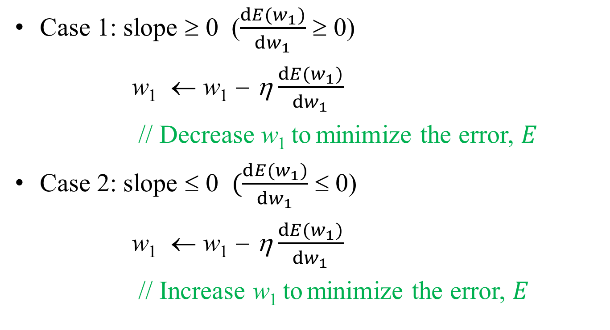
Gradient Descent – one weight (1/4)
Case 1: slope ≥ 0 ($\frac{d{E(w}_{1})}{dw_{1}}$ ≥ 0)
w₁ ← w₁ − η$\frac{d{E(w}_{1})}{dw_{1}}$
// Decrease w₁ to minimize the error, $E$
Case 2: slope ≤ 0 $(\frac{d{E(w}_{1})}{dw_{1}}$ ≤ 0)
w₁ ← w₁ − η$\frac{d{E(w}_{1})}{dw_{1}}$
// Increase w₁ to minimize the error, $E$

Slide 22
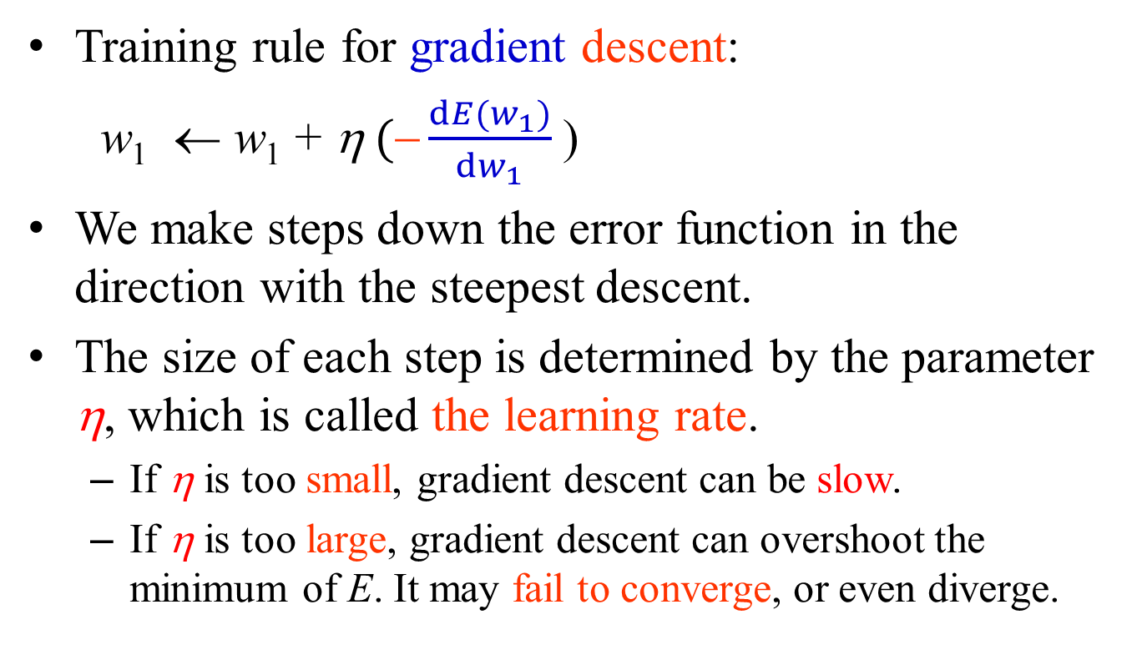
Gradient Descent – one weight (2/4)
Training rule for gradient descent:
w₁ ← w₁ + η$(\frac{d{E(w}_{1})}{dw_{1}}$)
We make steps down the error function in the direction with the steepest descent.
The size of each step is determined by the parameter η, which is called the learning rate.
If η is too small, gradient descent can be slow.
If η is too large, gradient descent can overshoot the minimum of E. It may fail to converge, or even diverge.

Slide 23
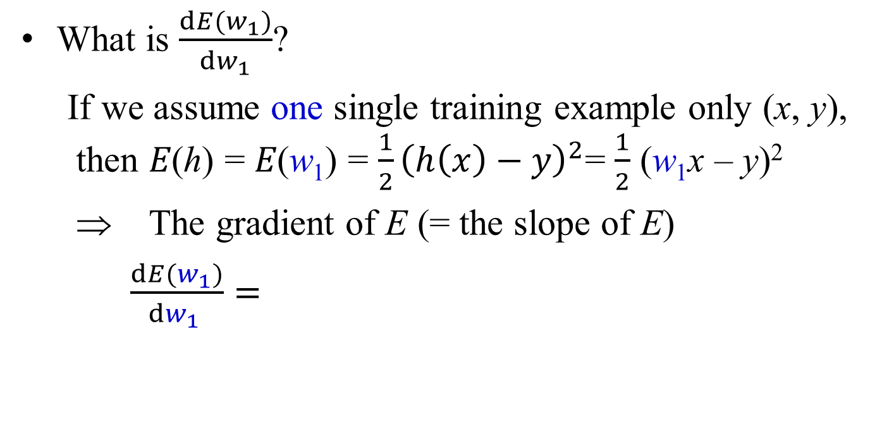
Gradient Descent – one weight (3/4)
What is $\frac{d{E(w}_{1})}{dw_{1}}$?
If we assume one single training example only (x, y), then 𝐸(ℎ) = 𝐸(w₁) = $\frac{1}{2}{\left(h\left(x\right)−y\right)}^{2}$= $\frac{1}{2}$ (w₁x – y)²
⇒ The gradient of E (= the slope of E)
$\frac{d{E(w}_{1})}{dw_{1 }}=$

Slide 24

Gradient Descent – one weight (4/4)
Training rule for gradient descent:
w₁ ← w₁ + η$(\frac{d{E(w}_{1})}{dw_{1}}$)
⇒ w₁ ← w₁ + η$($ )
⇒ w₁ ← w₁ + η

Slide 25
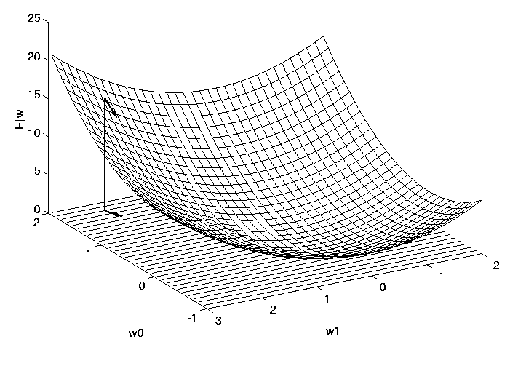
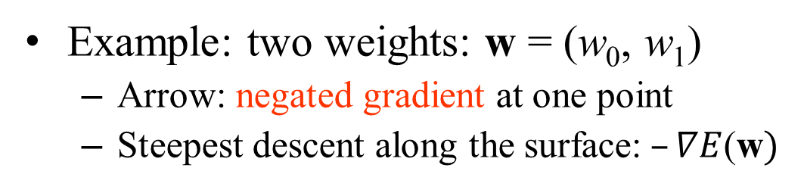
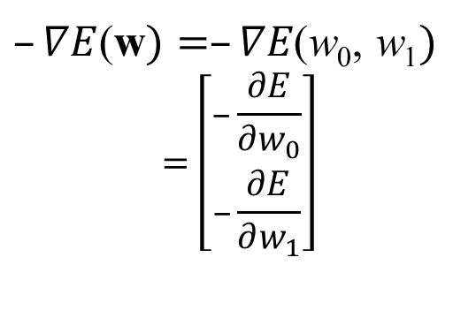
Error Function - two weights
Example: two weights: w = (w₀, w₁)
Arrow: negated gradient at one point
Steepest descent along the surface:$–∇E$(w$)$
$–∇E$(w$)=–∇E\text{(}\text{w}\text{0}\text{,} \text{w}\text{1})$
$$=\left[\begin{matrix}–\frac{∂E}{∂w_{0}} \\ –\frac{∂E}{∂w_{1}}\end{matrix}\right]$$

Slide 26
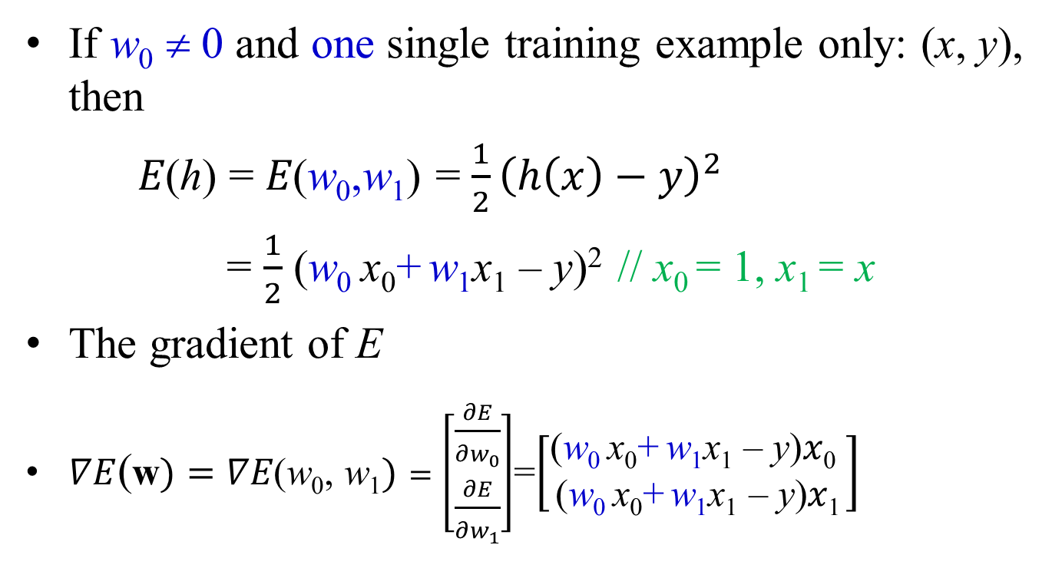
Gradient Descent – two weights (1/2)
If w₀ ≠ 0 and one single training example only: (x, y), then
𝐸(ℎ) = 𝐸(w₀,w₁) = $\frac{1}{2}{\left(h\left(x\right)−y\right)}^{2}$
= $\frac{1}{2}$ (w₀ x₀+ w₁x₁ – y)² // x₀ = 1, x₁ = x
The gradient of E
$∇E$(w$)=∇E\text{(}\text{w}\text{0}\text{,} \text{w}\text{1})=\left[\begin{matrix}\frac{∂E}{∂w_{0}} \\ \frac{∂E}{∂w_{1}}\end{matrix}\right]$=$\left[\begin{matrix}\text{(}\text{w}\text{0 }\text{x}\text{0}\text{+} \text{w}\text{1}\text{x}\text{1}\text{ – }\text{y}\text{)}x\text{0} \\ \text{(}\text{w}\text{0 }\text{x}\text{0}\text{+} \text{w}\text{1}\text{x}\text{1}\text{ – }\text{y}\text{)}x\text{1}\end{matrix}\right]$

Slide 27
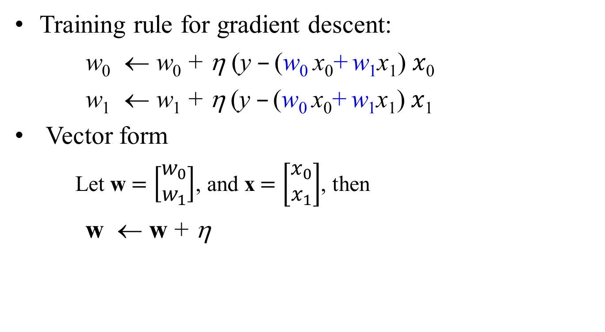
Gradient Descent – two weights (2/2)
Training rule for gradient descent:
w₀ ← w₀ + η $\text{(}\text{y} –\text{(}\text{w}\text{0 }\text{x}\text{0}\text{+} \text{w}\text{1}\text{x}\text{1}\text{)} x\text{0}$
w₁ ← w₁ + η$\text{(}\text{y} –\text{(}\text{w}\text{0 }\text{x}\text{0}\text{+} \text{w}\text{1}\text{x}\text{1}\text{)} x\text{1}$
Vector form
Let w$=\left[\begin{matrix}w_{0} \\ w_{1}\end{matrix}\right]$, and x$=\left[\begin{matrix}x_{0} \\ x_{1}\end{matrix}\right]$, then
w ← w + η

Slide 28
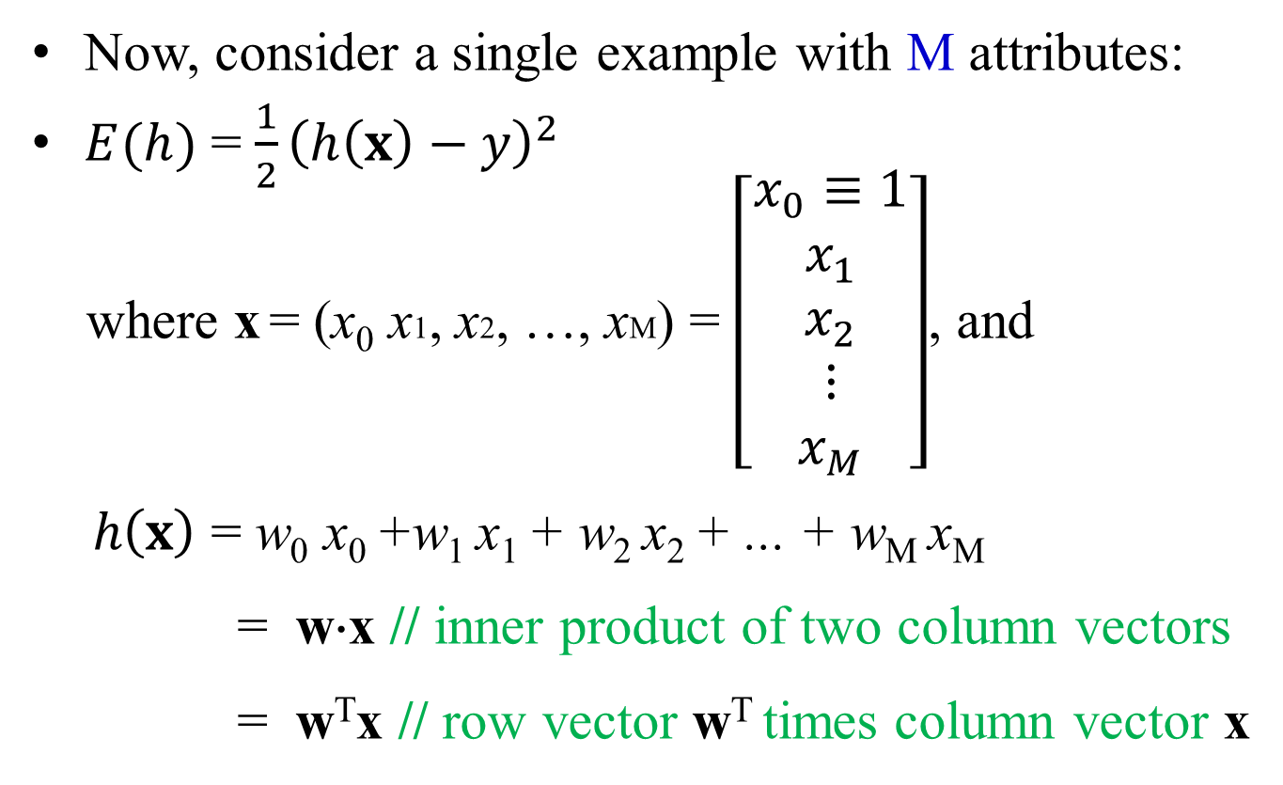
Error Function – (M+1) weights (1/2)
Now, consider a single example with M attributes:
$E(h)$ = $\frac{1}{2}{\left(h\left(x\right)−y\right)}^{2}$
where x = (x₀ x1, x2, …, xM) = $\left[\begin{matrix}x_{0}≡1 \\ x_{1} \\ x_{2} \\ ⋮ \\ x_{M}\end{matrix}\right]$, and
$h\left(x\right)$ = w₀ x₀ +w₁ x₁ + w₂ x₂ + ... + w_{M} x_{M}
= w⋅x // inner product of two column vectors
= w^{T}x // row vector w^{T} times column vector x

Slide 29
Error Function– (M+1) weights (2/2)
w = (w₀, w₁, w₂, w₃, ..., w_{M} ) is to be determined and to be fit in the learning problem.
The space H of candidate hypothesis is the set of all possible real-valued weight vectors:
H = {w| w ∈ R^{M+1}}
Q: How to determine a weight vector w?
A: Several algorithms are known to solve this learning problem. Here, we consider gradient descent again.

Slide 30
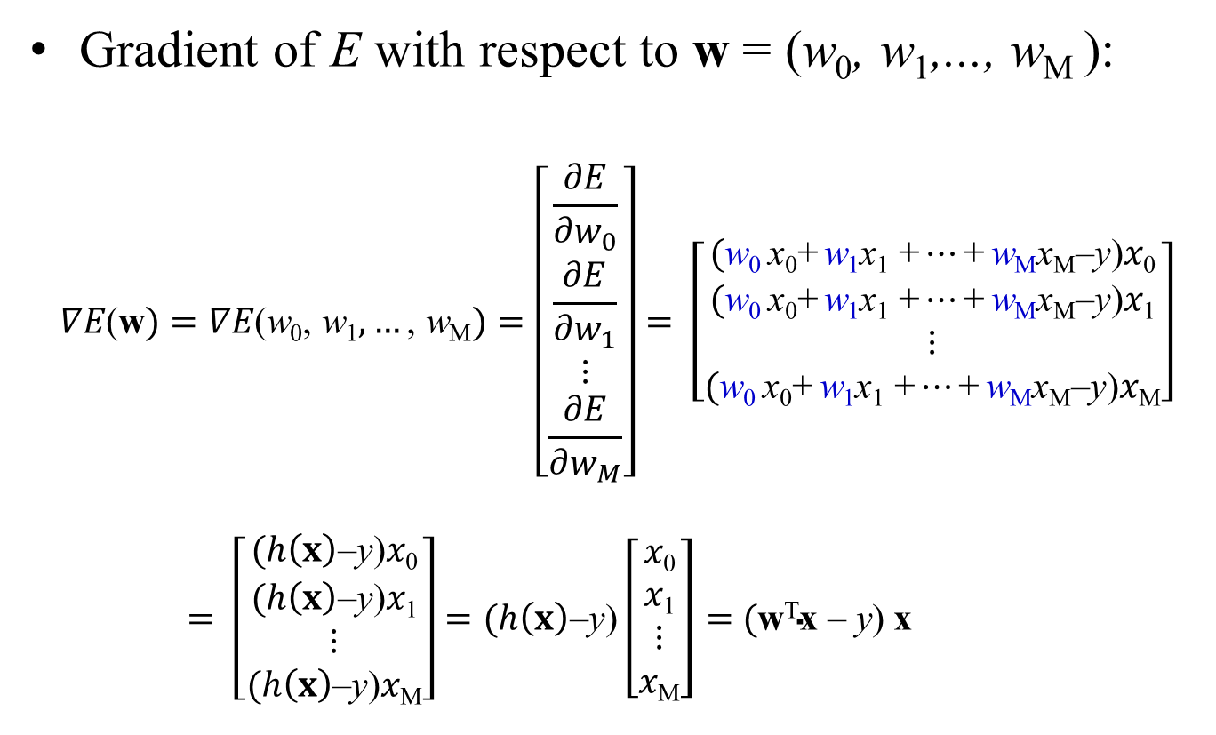
Gradient Descent – (M+1) weights (1/2)
Gradient of E with respect to w = (w₀, w₁,..., w_{M} ):
$$∇E\text{(}\text{w})=∇E\text{(}\text{w}\text{0}\text{,} \text{w}\text{1},…\text{,} \text{w}\text{M})=\left[\begin{matrix}\frac{∂E}{∂w_{0}} \\ \frac{∂E}{∂w_{1}} \\ ⋮ \\ \frac{∂E}{∂w_{M}}\end{matrix}\right]= \left[\begin{matrix}\text{(}\text{w}\text{0 }\text{x}\text{0}\text{+} \text{w}\text{1}\text{x}\text{1}\text{ +}…\text{+} \text{w}\text{M}\text{x}\text{M}\text{–}\text{y}\text{)}x\text{0} \\ \text{(}\text{w}\text{0 }\text{x}\text{0}\text{+} \text{w}\text{1}\text{x}\text{1}\text{ +}…\text{+} \text{w}\text{M}\text{x}\text{M}\text{–}\text{y}\text{)}x\text{1} \\ ⋮ \\ \text{(}\text{w}\text{0 }\text{x}\text{0}\text{+} \text{w}\text{1}\text{x}\text{1}\text{ +}…\text{+} \text{w}\text{M}\text{x}\text{M}\text{–}\text{y}\text{)}x\text{M}\end{matrix}\right]$$
$= \left[\begin{matrix}\text{(}h\left(x\right)\text{–}\text{y}\text{)}x\text{0} \\ \text{(}h\left(x\right)\text{–}\text{y}\text{)}x\text{1} \\ ⋮ \\ \text{(}h\left(x\right)\text{–}\text{y}\text{)}x\text{M}\end{matrix}\right]=\text{(}h\left(x\right)\text{–}\text{y}\text{)}\left[\begin{matrix}x\text{0} \\ x\text{1} \\ ⋮ \\ x\text{M}\end{matrix}\right]$ $=$ $\text{(}\text{w}\text{T}\text{x} \text{–} \text{y}\text{)}$ x

Slide 31
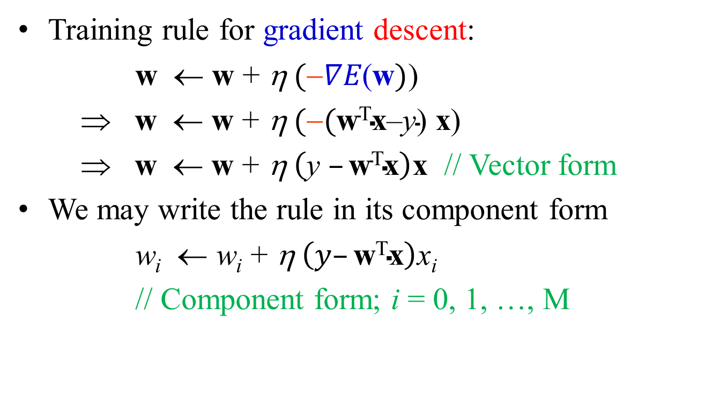
Gradient Descent – (M+1) weights (2/2)
Training rule for gradient descent:
w ← w + η$(∇E\text{(}\text{w})$)
⇒ w ← w + η$(\text{(}\text{w}\text{T}\text{x}\text{–}\text{y}\text{) }\text{x}\text{)}$
⇒ w ← w + η$\left(\text{y} –\text{w}\text{T}\text{x}\right)\text{x}$ // Vector form
We may write the rule in its component form
w_{i} ← w_{i} + η$\left(y–\text{w}\text{T}\text{x}\right)$x_{i}
// Component form; i = 0, 1, …, M

Slide 32
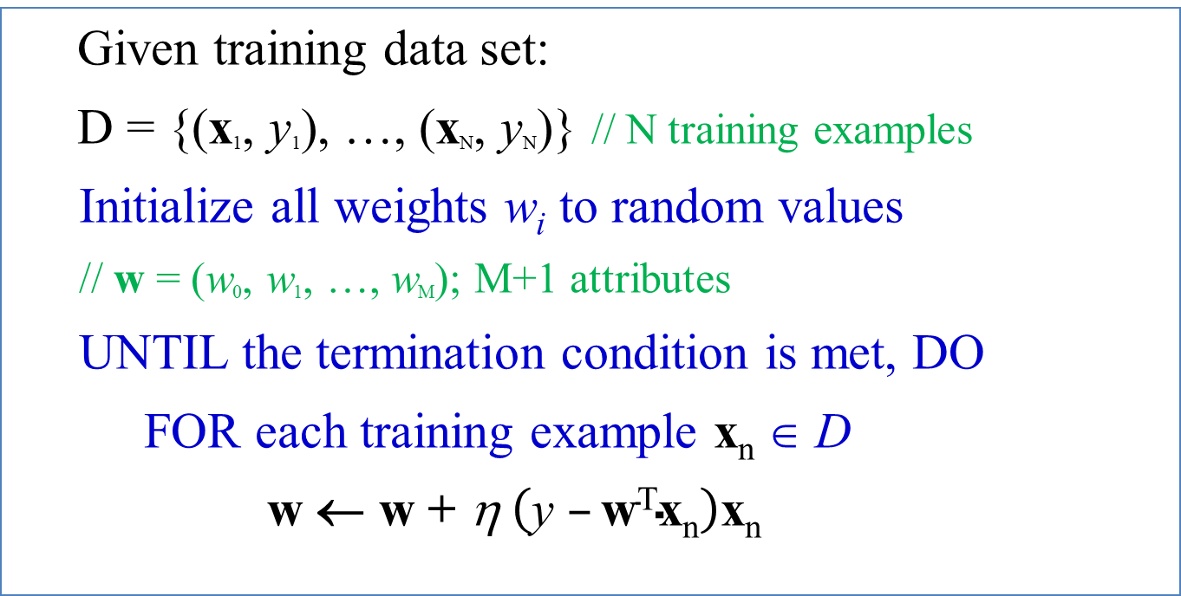
The Gradient Descent Algorithm
Given training data set:
D = {(x₁, y₁), …, (x_{N}, y_{N})} // N training examples
Initialize all weights w_{i} to random values
// w = (w₀, w₁, …, w_{M}); M+1 attributes
UNTIL the termination condition is met, DO
FOR each training example x_{n} ∈ D
w ← w + η$\left(\text{y} –\text{w}\text{T}\text{x}\text{n}\right)$x_{n}

